Slide 1
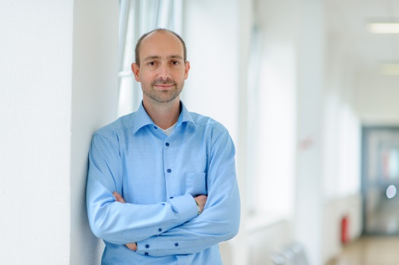
Chapter 3.4
Superposition of Independent Renewal Processes
Performance Evaluation of the Internet of Things (IoT)
Module Course: Performance Evaluation of Distributed Systems
Prof. Tobias Hoßfeld, Summer Semester 2022

Slide 2
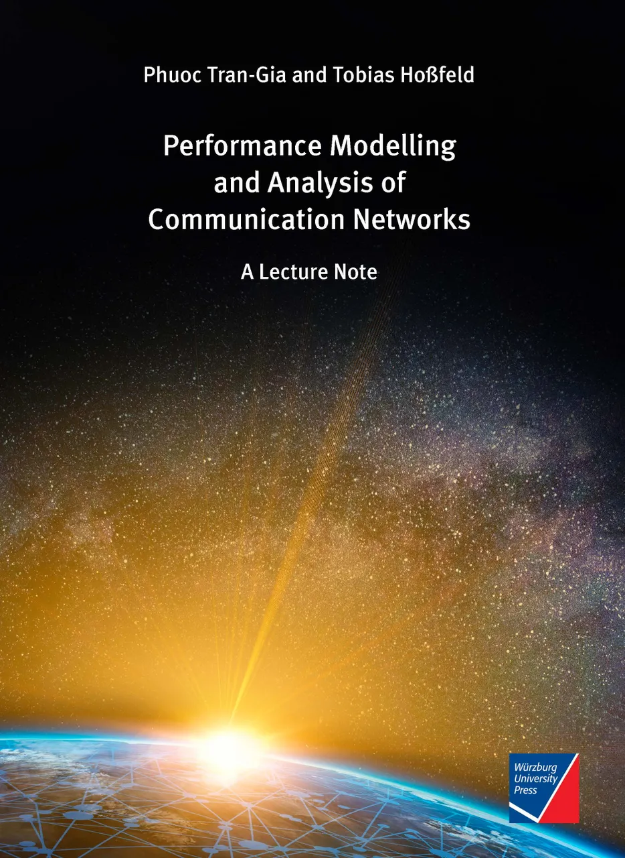
Disclaimer and Copyright Notice
Lecture slides, figures, and scripts are based on the open access text book “Performance Modeling and Analysis of Communication Networks”. The book and scripts are licensed under the Creative Commons License Attribution-ShareAlike 4.0 International (CC BY-SA 4.0). If you remix, transform, or build upon the material, you must distribute your contributions under the same license as the original.
The book must be cited and the disclaimer attached when using lectures slides or scripts.
Tran-Gia, P. & Hossfeld, T. (2021). Performance Modeling and Analysis of Communication Networks - A Lecture Note. Würzburg University Press. https://doi.org/10.25972/WUP-978-3-95826-153-2
Website to download book, exercises, slides and scripts: https://modeling.systems/

Slide 3
Chapter 3
3 Elementary Random Processes
3.1 Stochastic Processes
3.1.1 Definition
3.1.2 Markov Processes
3.1.3 Elementary Processes in Performance Models
3.2 Renewal Processes
3.2.1 Definition
3.2.2 Analysis of Recurrence Time
3.3 Poisson Process
3.3.1 Definition of a Poisson Process
3.3.2 Properties of the Poisson Process
3.3.3 Poisson Arrivals during Arbitrarily Distributed Interval
3.4 Superposition of Independent Renewal Processes
3.4.1 Superposition of Poisson Processes
3.4.2 Palm-Khintchine Theorem
3.5 Markov State Process
3.5.1 Definition of Continuous-Time Markov Chain
3.5.2 Transition Behavior of Markovian State Processes
3.5.3 State Equations and State Probabilities
3.5.4 Examples of Transition Probability Densities
3.5.5 Birth-and-Death Processes

Slide 4
Merging of Poisson Processes
Superposition of Poisson processes remains a Poisson process
Process 1: $A_{1}∼EXP\left(λ_{1}\right)$
Process 2: $A_{2}∼EXP\left(λ_{2}\right)$
Superposition $A∼EXP\left({λ_{1}+λ}_{2}\right)$
Proof: random observer sees minimum of recurrence times of both processes
recurrence time is exponentially distributed with same rate
$A=min⁡(A_{1},A_{2})$ with CDF $A\left(t\right)=1−\left(1−A_{1}\left(t\right)\right)⋅\left(1−A_{2}\left(t\right)\right)=1−e^{−\left(λ_{1}+λ_{2}\right)t}$
$A=min⁡(A_{1},A_{2})∼EXP\left({λ_{1}+λ}_{2}\right)$
In general: superposition of $n$ Poisson processes
$$A∼EXP(\sum_{i=1}^{n}{λ_{i}})$$

Slide 5
Palm-Khintchine Theorem
Superposition of renewal processes

Slide 6
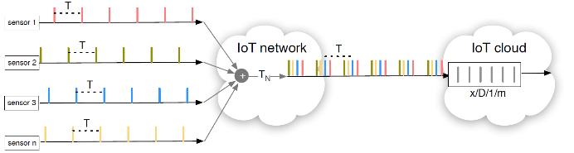

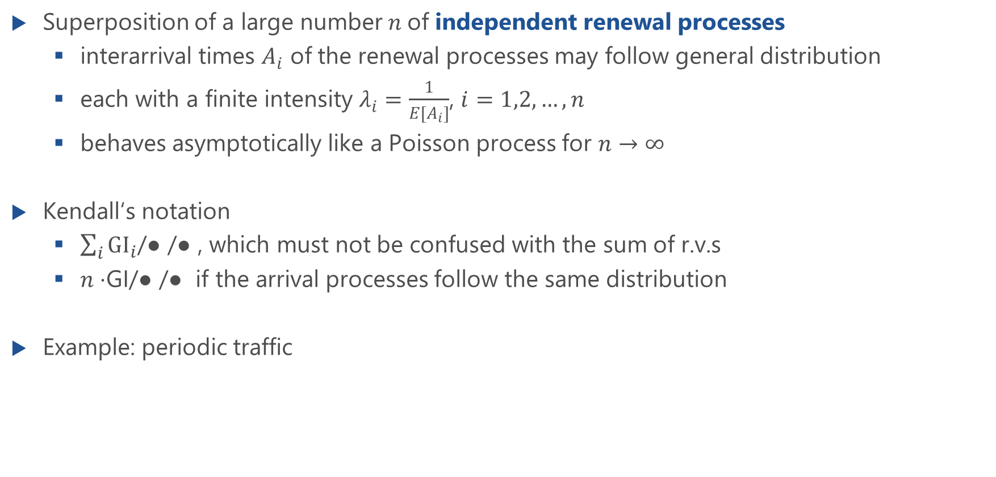
Palm-Khintchine Theorem
Superposition of a large number $n$of independent renewal processes
interarrival times $A_{i}$ of the renewal processes may follow general distribution
each with a finite intensity $λ_{i}=\frac{1}{E[A_{i}]}$, $i=1,2,…,n$
behaves asymptotically like a Poisson process for $n→∞$
Kendall‘s notation
$\sum_{i}{GI_{i}}$/● /● , which must not be confused with the sum of r.v.s
$n⋅$GI/● /● if the arrival processes follow the same distribution
Example: periodic traffic
large number $n$ …
… Poisson process !

Slide 7

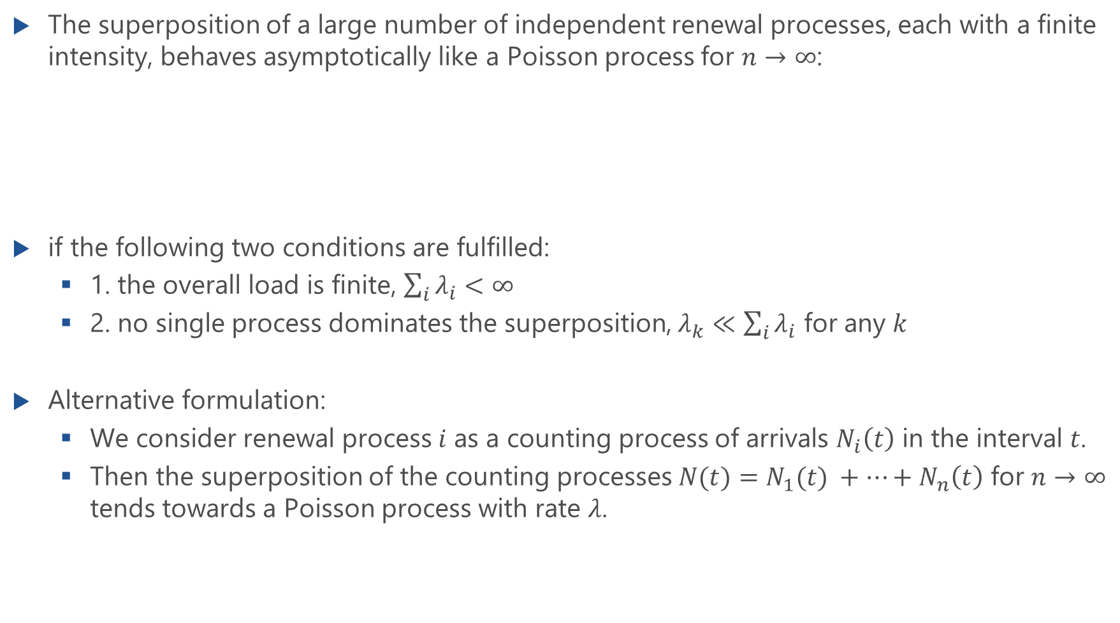
Formally: Palm-Khintchine Theorem
The superposition of a large number of independent renewal processes, each with a finite intensity, behaves asymptotically like a Poisson process for $n→∞$:
if the following two conditions are fulfilled:
1. the overall load is finite, $\sum_{i}{λ_{i}}<∞$
2. no single process dominates the superposition, $λ_{k}≪\sum_{i}{λ_{i}}$ for any $k$
Alternative formulation:
We consider renewal process 𝑖 as a counting process of arrivals $N_{i}\left(t\right)$ in the interval 𝑡.
Then the superposition of the counting processes $N(t)=N_{1}(t) +…+N_{n}\left(t\right)$ for $n→∞$ tends towards a Poisson process with rate $λ$.
$$A^{∗}∼EXP\left(\sum_{i}{λ_{i}}\right)$$

Slide 8
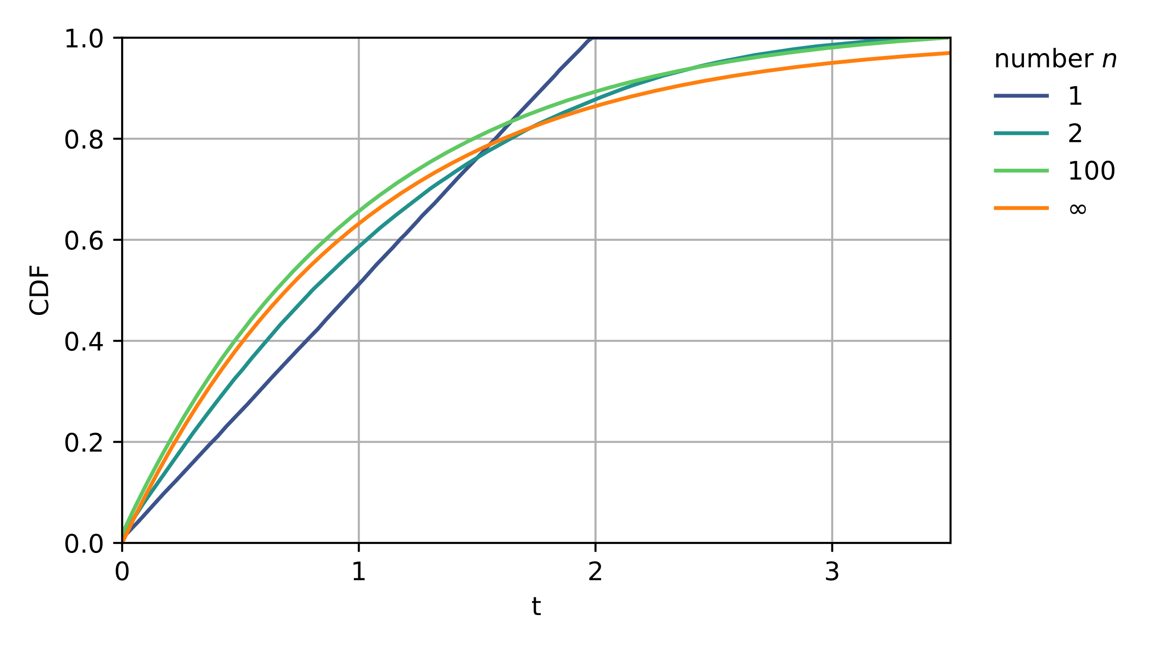
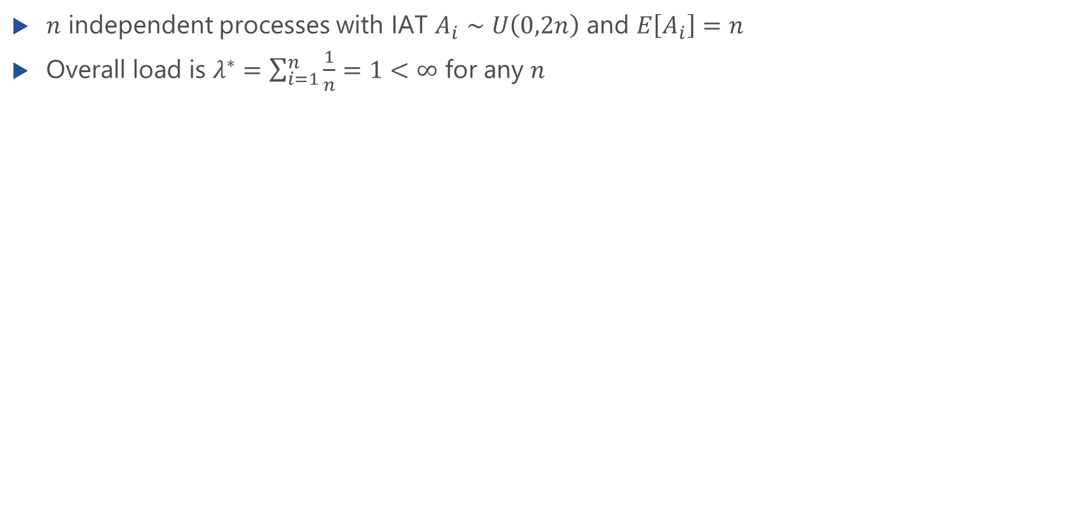
Example: Superposition of Uniformly Distributed IATs
$n$ independent processes with IAT $A_{i}∼U\left(0,2n\right)$ and $E\left[A_{i}\right]=n$
Overall load is $λ^{∗}=\sum_{i=1}^{n}{\frac{1}{n}}=1<∞$ for any $n$

Slide 9


Example: IoT Cloud
Many sensors send data to an IoT cloud
IoT Load Balancer distributes messages to servers in the cloud
IoT load balancer as a bottleneck
Deterministic message processing time
How to model the load balancer (Kendall notation)?
IoT Load Balancer

Slide 10
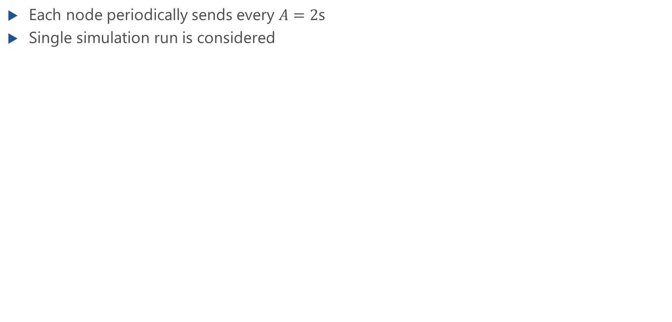
Asynchronous Sensors
Each node periodically sends every $A=2$s
Single simulation run is considered

Slide 11
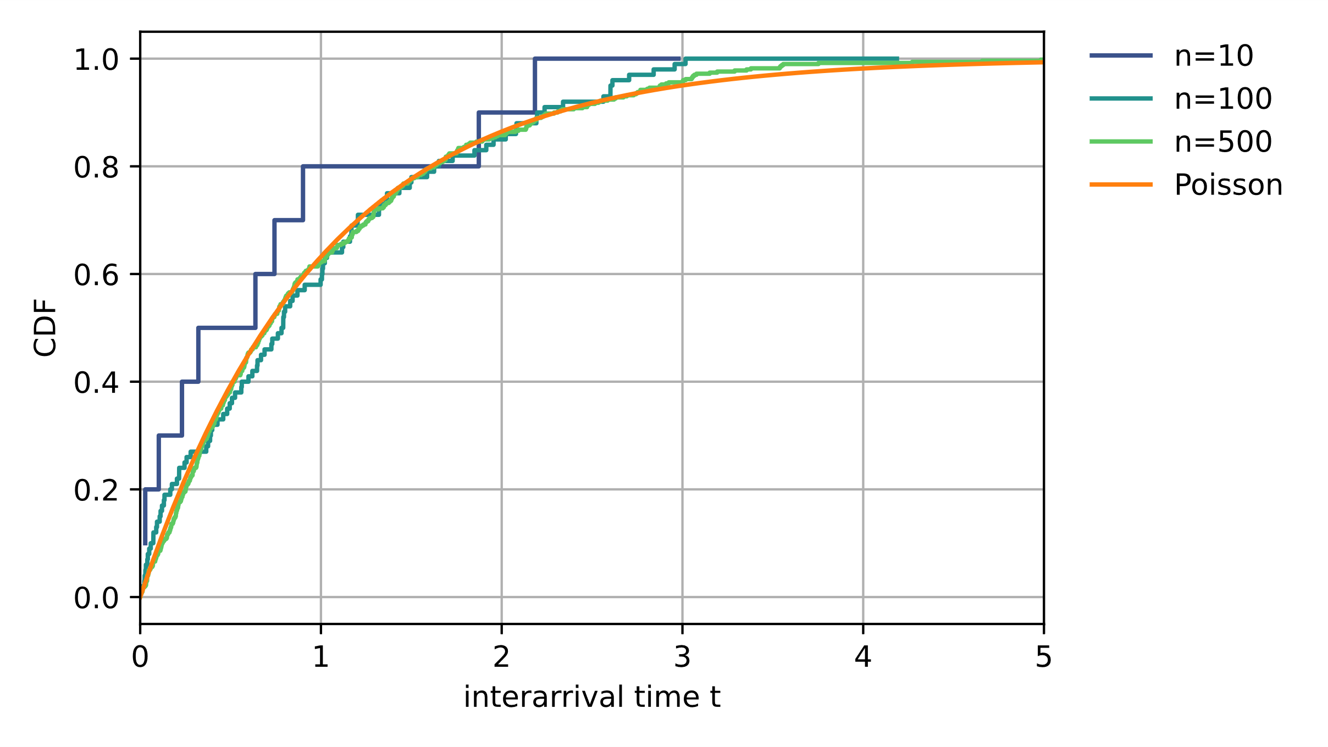
Asynchronous Sensors (f.)

Slide 12
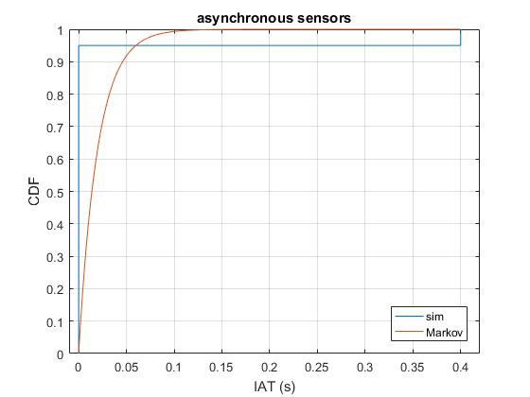
Synchronous Sensors
How to model the different scenarios?
asynchronous
synchronous

